Slide 1



Equities focused budget review: More empty promises?
Lerato Matibidi (CA) (SA)
Equity Research
11 March 2021 Webinar

Slide 2

Topics covered
Economic landscape
  Local
  Global
Economic Recovery & Reconstruction plan
  Infrastructure
  Spectrum allocation
  Energy
Notes:
A lot of things were said in the budget speech. However, I will be going through the key highlights, with an equities focus. I will then go through some of the ETFs that we think are well positioned to perform well, should there be any credibility to the budget.
With a lot to digest, we will go straight into the economic outlook for both the local and global markets.
I will then provide summary of the Economic Recovery and Reconstruction plan which was first announced in October 2020, also mentioned in both the recent SONA and budget speech

Slide 3
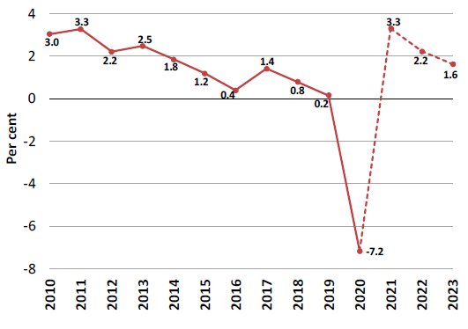
The local economy
Real GDP growth and projections
GDP growth forecasts
Economic recovery
Vaccine rollout:
R10.3bn for the vaccine programme
Vaccinate 67% of the population in next 12 months
R5bn increase towards the contingency reserve for emergency allocations
Inefficient rollout may affect this year’s GDP growth
Source: Full budget review (Statistics South Africa, National Treasury forecast)
Notes:
The South African economy has been struggling to grow meaningfully even before Covid-19, growing by less than 2% since 2014
The economy has been characterised by high government spending, a growing debt to GDP ratio, bailing out SOEs such as Eskom and SAA
GDP was estimated to contract by 7.2% in 2020, then grow by 3.3% this year, with the long term growth at 1.6%
On Tuesday, we saw the 2020 GDP numbers come in at less than the forecast, with a better than expected contraction of 7%
Still economic growth is expected to remain well below the pre-pandemic levels until 2023
Given that the economy was already struggling even before Covid-19, its recovery will be slower than many of its developing-country peers
The real driver of short term growth will be success in containing Covid-19 spread. A mass vaccine rollout will support full reopening of the economy
R10.3bn has been set aside for the vaccine programme, with the aim of vaccinating 67% of the population in the next 12 months
There is also an increase of R5bn for the contingency reserve and emergency allocations
A risk to the economic growth is inefficient rollout of vaccines
The vaccination process is not going well. The 160 000 doses of J&J available are not being rolled out as fast as possible (it is below the target of hitting 12 500 people per day)
We expect that we will run out of the J&J vaccine in two weeks’ time. Pfizer vaccines via COVAX are due to arrive which will then take over but these might only arrive into April, leaving a gap.
SA’s COVAX doses from Oxford/AstraZeneca are due to be redistributed through to other countries leaving SA now with no other available COVAX doses till mid-year.

Slide 4
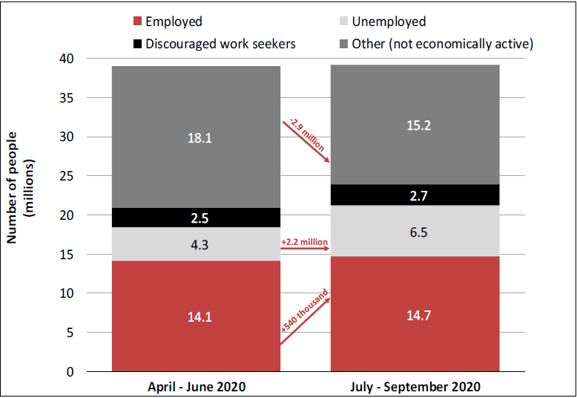
Household income: Labour market dynamics
Unemployment rate rose to 30.8% in Q3 from 23.3% in Q2
The number of unemployed jumped from 4.3m to 6.5m
Of those that are employed, 12% received no pay from their employers in Q3
Nearly 1 in 5 of the workers who were paid, reported a salary reduction
R13bn has been allocated for the Presidential Employment Stimulus plan
Source: Full budget review (Statistics South Africa)
Notes:
What this anaemic economic growth translates to for the people of South Africa is a growing unemployment rate ( with graduates standing on robots with their CVs asking to be hired)
One would think that these Twitter images are an exaggeration of reality, but it is not. The recent unemployment data shows that unemployment rate rose from 23.3% in Q2 2020, to 30.8% in Q3
The number of unemployed jumped from 4.3m to 6.5m as those who couldn’t look for jobs because of restrictions have now rejoined the labour force but could not find work
Most of the job losses are in the informal sector, hence the impact on macro level consumption
This is why the focus on the rollout of the employment stimulus scheme is important. And the extension of the Covid-grants to April this year, instead of January
Even those that were employed suffered a blow as a result of the impact of the pandemic on businesses
Of those that were employed, 12% received no pay from their employers in Q3
Nearly 1 in 5 of the workers who were paid, reported a salary reduction
To drive employment, R13bn has been allocated for the Presidential Employment Stimulus plan

Slide 5
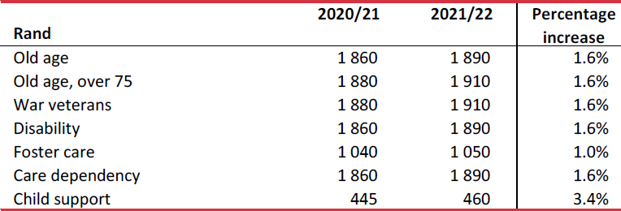
Household income: taxes & grants
Average monthly social grant values
Tax relief: Personal income tax brackets and rebates will increase by 5% ( which is above the current inflation of 3.2%)
An inflationary adjustment will apply to the value of tax credits
Limited impact of inflation
This means that taxpayers will pay less income tax this year than they did in the previous year
Below inflationary increase in social grants
Notes:
When we look at household income, a relief should come from the announced tax relief
Personal income tax brackets and rebates will increase by 5% ( which is above the current inflation of 3.3%)
Increasing the income brackets limits the prospects of higher personal income tax that would be payable due to annual salary increases (likely in line with inflation) so that inflation does not automatically increase the individual tax burden
An inflationary adjustment will also apply to the value of tax credits
This means that essentially as a taxpayer you will pay less income tax this year than you did in the previous year
This tax relief also means that workers’ get back more rands in their pocket
Disappointing though has been the below inflation increase in social grants, which a third of the South African population rely on as their main source of income. All grants (except for child support grant) increased by below 2%

Slide 6
Household consumption
Real GDP per person has been falling since 2013/14
Household consumption grew by 69.5% in the third quarter compared with the previous quarter. Although set to rebound in 2021, it is expected to decline in 2023
Consumer confidence has partially recovered but consumers are reluctant to take credit because of the threat of job losses, declining future incomes and a reduced ability to service debts
Household savings as a share of disposable income reached a 15-year high
Sin taxes:
Fuel levy to increase by 15c/litre
Road Accident Fund levy to increase by 11c
Carbon tax by 1%
Tobacco and alcohol excise duties to increase by 8%
Source: Full budget review (National Treasury, Reserve Bank and StatsSA)
Notes:
All the above has a direct impact on disposable income and household consumption
Household consumption real GDP per person has been falling since 2013/2014
This means that the average South African’s spending capacity is quite low
The January 2021 Household Affordability Index showed that basic food items like beans, rice, flour and bread have seen price hikes of between 31% and 68%. And that a food basket for the average South African costs around R4 051, which is more than the minimum wage of R3 321
The lower per capita GDP since 2013/14 also means that the average South African is becoming poorer
Household consumption grew by 69.5% in the third quarter of 2020 from the previous quarter. Although set to rebound in 2021, it is still quite low and set to decline in 2023
Consumer confidence has partially recovered but consumers are reluctant to take credit because of the threat of job losses, declining future incomes and a reduced ability to service debts
This is despite having the lowest nominal interest rates in decades
In addition, increases in nominal incomes were not fully spent, with household savings as a share of disposable income reaching an impressive 15-year high
The tax relief discussed in the previous slide is likely to be paid back through the various sin taxes which increase overall cost of living, especially for those who do not get the personal tax benefits (the unemployed and those earning untaxed incomes).
These sin taxes include:
Fuel levy increase of 15c/litre
Road Accident Fund levy to increase by 11c
Carbon tax by 1%
Tobacco and alcohol excise duties to increase by 8%

Slide 7
Corporate tax
Positive for the equities market is the lowering of the corporate income tax rate to 27% effective from April 2022 (from 28%)
South Africa has a high corporate tax rate compared with countries with similar economies
Companies would rather move their operations to lower tax jurisdictions
A decrease in corporate tax increases company earnings which drive investment as they translate into cash flow
Notes:
Positive for the equities market is the lowering of the corporate income tax rate to 27% effective from April 2022 (from the current 28%)
South Africa has a high corporate tax rate compared with countries with similar economies
Companies would rather move their operations to lower tax jurisdictions, which then leaves many unemployed
A decrease in corporate tax increases company earnings which drive investment as they translate into cash flow. This will also drive employment as the impact of tax on profits reduces

Slide 8
The global economy
Global economic rebound
Vaccine rollout
Stimulus measures
The US to approach 2019 levels of economic activity this year
The eurozone and Japan are expected to reach 2019 levels of economic activity only by 2023
China is expected to be ahead of developing economies, with 8.1% GDP growth forecast in 2021
India’s economy has recovered quicker than anticipated, and is expected to post growth of 11.5% in 2021.
Source: Full budget review (IMF World Economic Outlook, January 2021)
Notes:
As outlined, the South African economy is under pressure. Sectors such as retail, tourism, and hospitality will face headwinds from the weak consumer spending as well as sin taxes eating into disposable incomes
We think an investor would benefit more from the global recovery than what the local market has to offer
As you can see in the graph, global economic growth is expected to rebound, driven by additional policy stimulus and the rollout of Covid-19 vaccines
The recovery is expected to remain fragile and uneven across countries and regions
Some countries have reimposed Covid-19 containment measures and large economies such as United States, European Union, Japan and India announced additional stimulus measures
Efficacy of vaccine rollout and impact of stimulus measures will drive economic growth
The US is expected to approach 2019 levels of activity this year, due to expansive fiscal stimulus and accommodative monetary policy
The Euro area and Japan are only expected to reach 2019 levels of economic activity by 2023 – despite large stimulus – owing to differing responses to COVID-19 infections, low adaptability to a low-mobility economy and other structural rigidities
China is expected to spearhead a recovery among developing economies, with 8.1% GDP growth forecast in 2021. This is premised on its significant state-led investment drive, central bank liquidity support and effective Covid-19 containment measures
India’s economy has recovered more quickly than anticipated, and is expected to post growth of 11.5% in 2021.

Slide 9
ETFs: Emerging Markets
Notes:
As seen in the graph on the previous slide, GDP forecasts, emerging markets are expected to outgrow the global and developed economies
When looking at the equities market, ETFs with a global focus are more attractive than local ones
The global economy rebound, further stimulus packages and vaccines rollouts have been lifting the mood in the equities markets as well as investors’ risk on sentiments
This benefits emerging market equities – when the market expects economic progress and less volatility, investors are more likely to take on more risk
Emerging markets are considered riskier than developed markets, and generally offer higher yields
The Satrix MSCI Emerging Markets Feeder ETF (listed locally), and the Vanguard Emerging Markets ETF (listed in Australia) are both well positioned to benefit from this
The Satrix ETF has a total expense ratio of 0.40%, with above average performance as seen in the graphs
The Vanguard ETF has a total expense ratio of 0.48%.
One could also consider another Australian listed ETF (iShares MSCI Emerging Markets ETF), which has performed better than the Vanguard fund but a bit more pricey with a total expense ratio of 0.7%.

Slide 10
ETFs: FANG+ exposure
Notes:
With the rebound in the global GDP and overall positivity in the equities market, the largest global stocks are set to benefit
These 2 funds, the FANG+ and Total Stock Market ETF, are a cost-effective way for an investor to invest in the largest companies in the world, mainly, Facebook, Amazon, Apple, Netflix and Alphabet (you would know it as Google)
These are most popular and best-performing technology companies in the US, household brands that are used by consumers on a daily basis
Currently, they make up an estimated 18% of the S&P 500, which is significant because the S&P500 is viewed as a proxy for the US market.
The FANG+ ETF has closely tracked the New York Stock Exchange FANG+ Index, and significantly outperformed the S&P 500 index
It has a total expense ratio of 0.35%.
The Total Stock Market ETF is cheap, with a total expense ratio of 0.03%. It is also diversified as it has holdings in other companies that are market leaders in their industries (such as Tesla, Johnson & Johnson, Pfizer, Nike) to name a few
Important to mention that the funds are only available on the Australian platform on EasyEquities

Slide 11
Economic Recovery & Reconstruction
To drive economic growth, government announced an economic recovery plan
Some of the key focus areas of the plan include:
Infrastructure investment, including spectrum auction
Energy generation
Supporting the recovery of the tourism industry
Localisation
Government will implement various recovery plans through Operation Vulindlela
Operation Vulindlela is a joint initiative of the Presidency and the National Treasury with the purpose of accelerating the reforms determined by the President.
It works to identify and remove blockages and provides support but does not itself implement the reforms – that is done by government departments/SOEs etc.
The initiative is run by a small technical team that draws on additional expertise and capacity in the public and private sectors
Notes:
To drive economic growth, government announced in October 2020 an economic recovery plan. A successful implementation of this would drive growth in the broad local equities market and so important to keep track of progress, although there is no specific ETF recommendation for this
Some of the key focus areas of the plan include:
Infrastructure investment, including spectrum auction
Energy generation
Supporting the recovery of the tourism industry
Localisation
Government will implement various recovery plans through Operation Vulindlela
Operation Vulindlela is a joint initiative of the Presidency and the National Treasury with the purpose of accelerating the reforms determined by the President.
It works to identify and remove blockages and provides support but does not itself implement the reforms – because that is done by government departments/SOEs etc.
The initiative draws on additional expertise and capacity in the public and private sectors
I will just touch on the first 3 key elements of the economic recovery plan

Slide 12
Economic Recovery: Infrastructure drive
Low economic growth and increasing debt levels after the global financial crisis have led to difficulties in the construction sector
The 2010 Fifa World Cup somewhat revived the industry, but since then there has been little construction activity
Gross fixed capital formation has been flat, down by a compounded annual rate of 1.2% in 2019, since the 10-year peak of R635bn in 2015
The total capital expenditure by government has fallen, especially in the new construction category
Government’s spending on new construction declined by 6.6% from R194bn in 2016 to R158bn in 2019
R100bn for the infrastructure fund
Source: Statistics South Africa
Notes:
Key part of Operation Vulindlela is the infrastructure drive to revive the construction sector, create jobs and drive the economic recovery
Low economic growth and increasing debt levels after the global financial crisis has led to difficulties in the construction sector
The 2010 world cup somewhat revived the industry, but since then there has been little activity in the industry
Gross fixed capital formation has been flat, down by a compounded annual rate of 1.2% in 2019, since the 10-year peak of R635bn in 2015
The total capital expenditure by government reduced, especially in the new construction category
Government’s spending on new construction declined by 6.6% from R194bn in 2016 to R158bn in 2019
This has led to some construction firms filing for business rescue
Government has set aside R100bn for the infrastructure fund to finance blended infrastructure projects over the next 10 years, and attract private-sector investment for infrastructure projects
Some contracts have already been awarded to build: Raubex received two contracts from SANRAL
One for R1.43bn for upgrading N2 from Kwamashu to Umdloti River Bridge
Another for R1.44bn for upgrading N3

Slide 13
Economic Recovery: Infrastructure drive
The key risk here is the potential lack of capacity in the sector to roll out these infrastructure projects
Encouraging is the fact that SA has a strong framework that allows for infrastructure investment in public-private partnerships (PPPs), although the number of PPPs for infrastructure has declined
One indication of the decline is that no new PPPs have been registered in the National Treasury framework since 2017
Some of the catalysts needed for ideal investment conditions for infrastructure spending include:
Policy clarity and certainty to boost business confidence and to reduce the trust deficit between public and private sector
Adequate human and financial resources in government to administer project processes
A clear framework that can be used to determine the appropriate approach for each project
Notes:
The key risk here is the potential lack of capacity in the sector to roll out these infrastructure projects
Encouraging is the fact that SA has a strong framework that allows for infrastructure investment in public-private partnerships (PPPs), although the number of PPPs for infrastructure has declined
One indication of the decline is that no new PPPs have been registered in the National Treasury framework since 2017
Some of the catalysts needed for ideal investment conditions for infrastructure spending include:
Policy clarity and certainty to boost business confidence and to reduce the trust deficit between public and private sector
Adequate human and financial resources in government to administer project processes
A clear framework that can be used to determine the appropriate approach for each project
My colleague has a nice detailed report on the construction sector, which sets out our views on whether the local industry has the capacity to meet the infrastructure pipeline – check it out on Intellidex’s LinkedIn page

Slide 14
Economic Recovery: Spectrum auction
High data costs
The scarcity of spectrum is because of growth in traffic volumes on mobile networks because of the use of streaming, video conferencing and social media
The numerous delays in spectrum allocation has increased the cost for mobile network operators to deploy communication services.
The licensing of the spectrum aims to achieve the following:
Remedy high data costs
Enable greater access to rural areas for communication
Reduce barriers to entry in the ICT sector
Improve ease of doing business in South Africa
Improve South Africa’s global competitive rankings
Accelerate technology and 5G deployment – simulate innovation
Notes:
Tired of high data costs – this is for you
Another key element of recovery plan is the auctioning of spectrum – which will benefit the telecommunications and technology companies
The Competition Commission’s 2019 Final Data Market Inquiry confirmed the long-standing concern among South African consumers that data costs were exorbitant.
Both mobile network operators and the commission agree that the under-allocation of spectrum by government is the main contributor
The scarcity of spectrum is because of growth in traffic volumes on mobile networks because of the increased use of streaming, video conferencing and social media
The numerous delays in spectrum allocation has increased the cost for mobile network operators to deploy communication services.
The licensing of the spectrum will achieve the following:
Remedy high data costs
Enable greater access to rural areas for communication
Reduce barriers to entry in the ICT sector
Improve ease of doing business in South Africa
Improve South Africa’s global competitive rankings
Accelerate technology and 5G deployment – simulate innovation
Current delays to this include court cases around the auction process- one between ICASA and MTN, and the other between ICASA and Telkom as well as etv

Slide 15
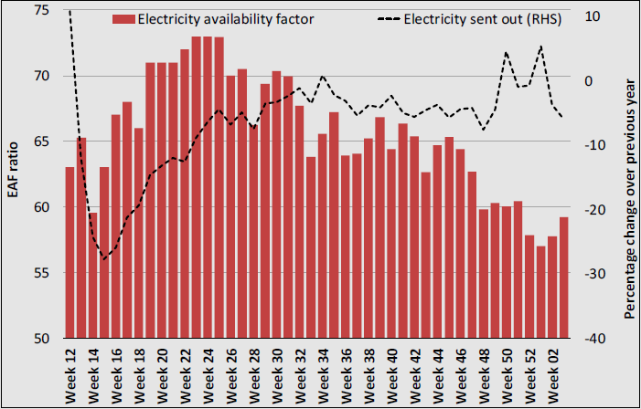
Economic Recovery: Energy generation
Unreliable electricity supply – constraint to economic recovery
Eskom – unable to meet demand
Operation Vulindlela interventions:
Reduce administrative burden for generation projects
Fast-track procurement of additional electricity
Improve municipal distribution infrastructure
Source: Full budget review (Eskom)
Notes:
Lastly, we look at increasing energy supply
This is important for me and you because, I don’t know about you but I am tired of load shedding
Even with the reduced economic activity during lockdown - since businesses that consume high percentage of electricity were not operating – Eskom was unable to meet demand
In 2020, load shedding reached its highest levels since 2015 (cumulative 52 days of power cuts vs 103 days in 2015)
As you can see in the graph, the electricity availability factor (EAF), which measures plant availability, mostly remained below 2019 levels to average, reflecting a deterioration in plant performance
Unreliable electricity supply is a constraint to economic recovery (many sectors like mining suffer due to disruptions in electricity)
Operation Vulindlela aims to accelerate these interventions:
Reducing the administrative burden for generation projects under 50 megawatts
Fast-tracking the procurement of additional electricity in line with the Integrated Resource Plan 2019
Improving municipal distribution infrastructure through private-sector investment
And implementing a national programme to support electricity planning and procurement

Slide 16
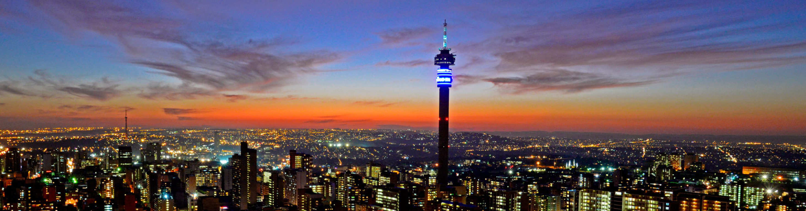
Intellidex (Pty) Ltd
1st Floor, Building 3
Inanda Greens Office Park
54 Wierda Road West
Sandton
2194
South Africa
Tel: +27 (0)11 084 5200
Email: mail@intellidex.co.za
Intellidex UK Limited
84 Eccleston Square
London
SW1V 1PX
United Kingdom
Tel: +44 20 3286 0774
Email: mail@intellidex.co.uk
Intellidex USA Inc
15th Floor
50 Milk Street
Boston, MA
02109
United States of America
Tel: +1 617 817 5304
Email: mail@intellidexinc.com
Any questions?
www.intellidex.co.za
lmatibidi@intellidex.co.za
Notes:
Although we think that these economic recovery plan initiatives are key to opening up the construction and ICT sector, their contribution to overall economic growth might not be as significant as government makes them out to be
Also, as already mentioned, successful implementation of these initiatives will benefit the broad equity market, and impact different sectors – hence I did not provide specific ETF recommendations here, but pointing them out as important growth catalysts to look out for, for your portfolios.

