Slide 1
Stealthy Wealth
How To Read ETF Fact Sheets
This is not financial advice
www.stealthywealth.co.za
@stealthy_wealth

Slide 2

What Is A Fact Sheet?
Also called a MDD – Minimum Disclosure Document
A MDD is a document about an ETF (or Unit Trust) offered by an investment company.
Regulated and monitored by the Financial Sector Conduct Authority (FSCA).
  How often to publish
  What must be in it

Slide 3
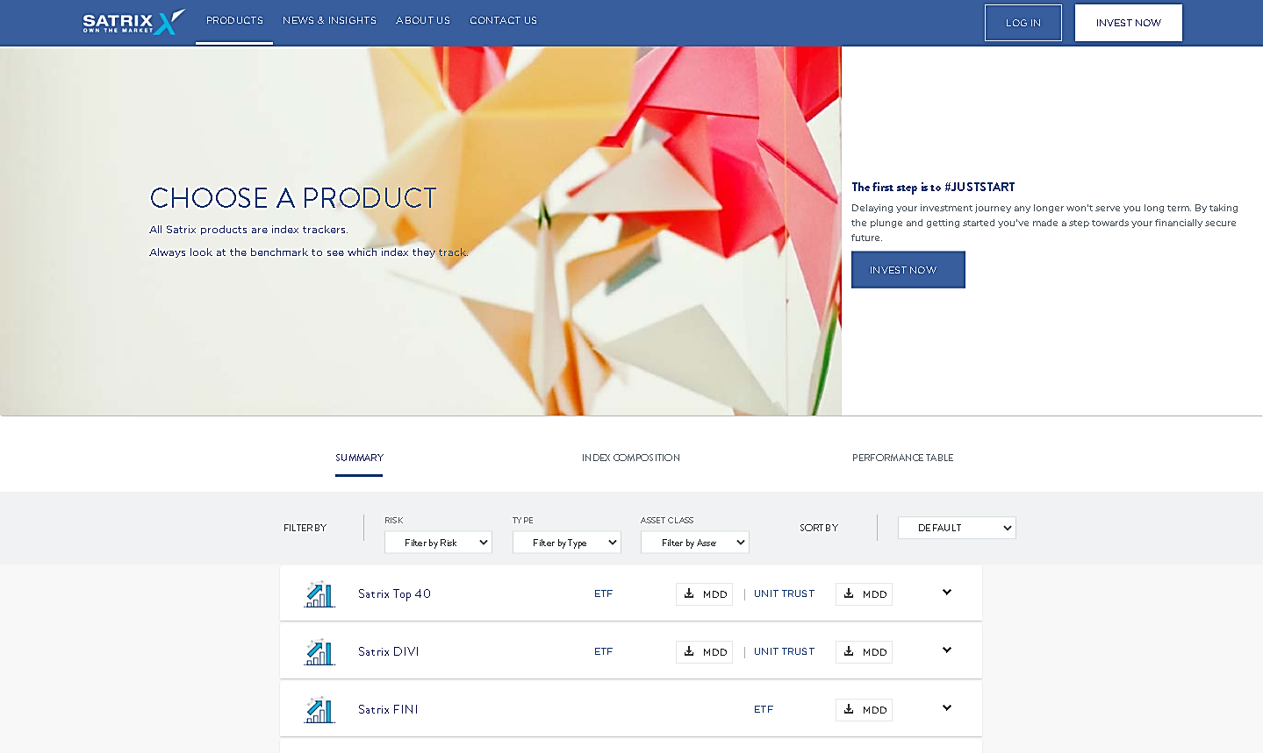
Where Do You Find Fact Sheets (MDDs)?
Google?
On the provider’s website

Slide 4
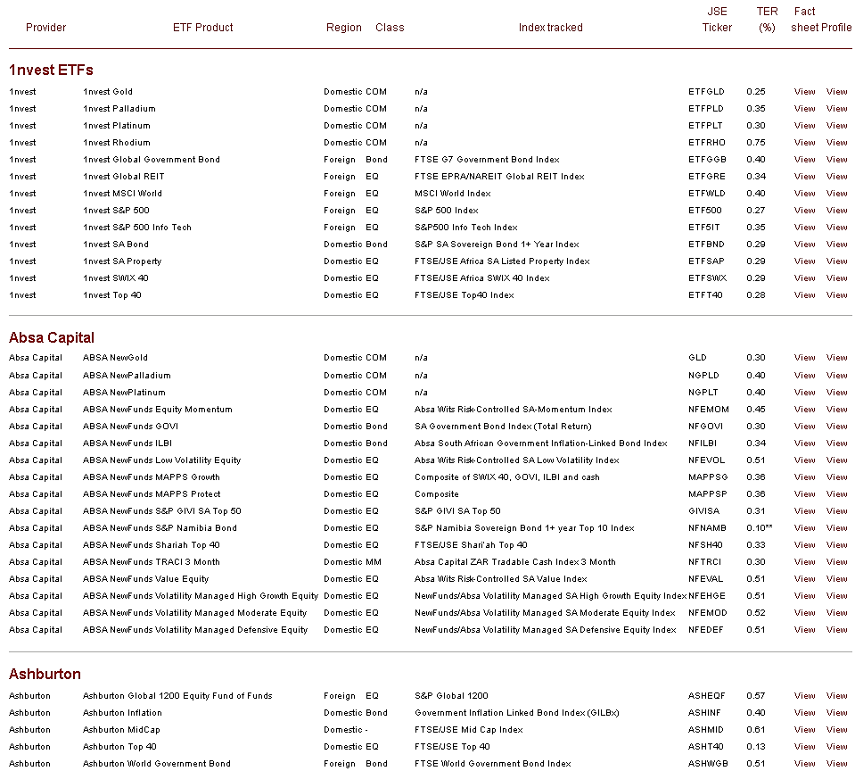
Where Do You Find Fact Sheets (MDDs)?
ETF Websites
ETFSA
http://www.etfsa.co.za/ETFs.htm

Slide 5
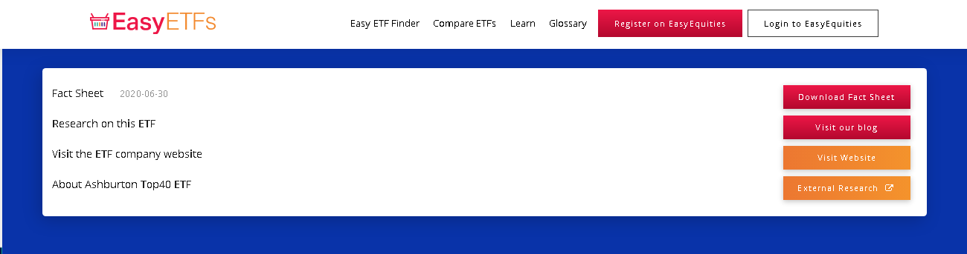
Where Do You Find Fact Sheets (MDDs)?
ETF Websites
EasyETFs
http://www.easyetfs.com/

Slide 6

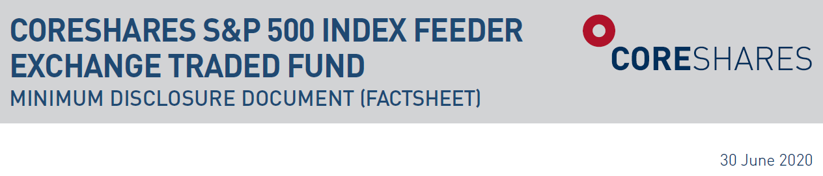
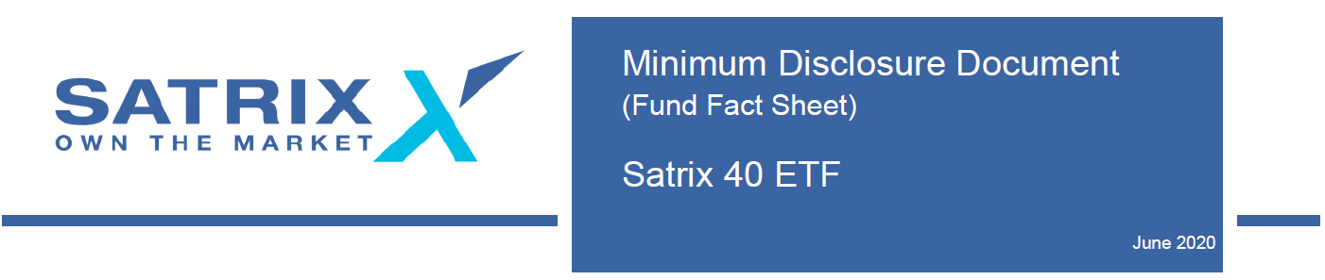
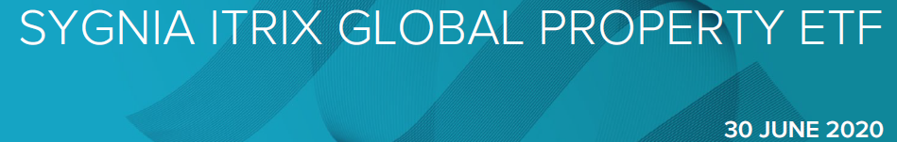
How To Read MDDs
For this we will be using

Slide 7
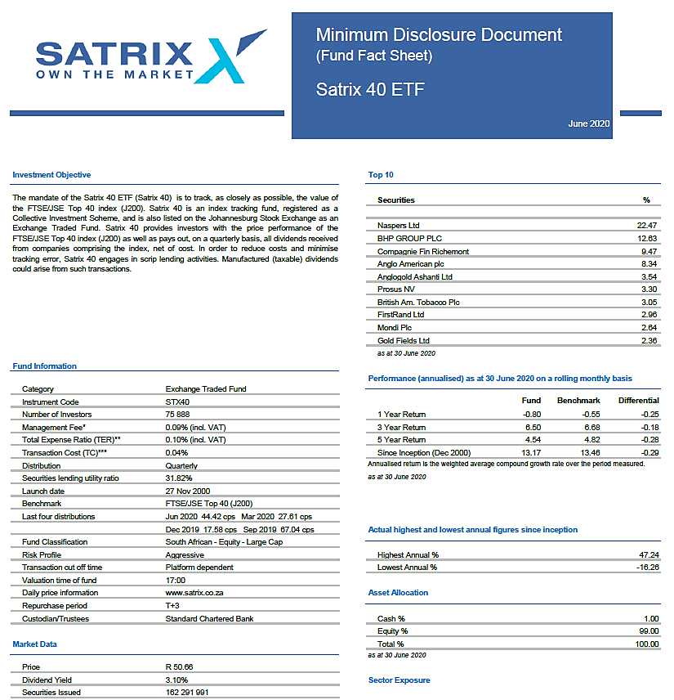
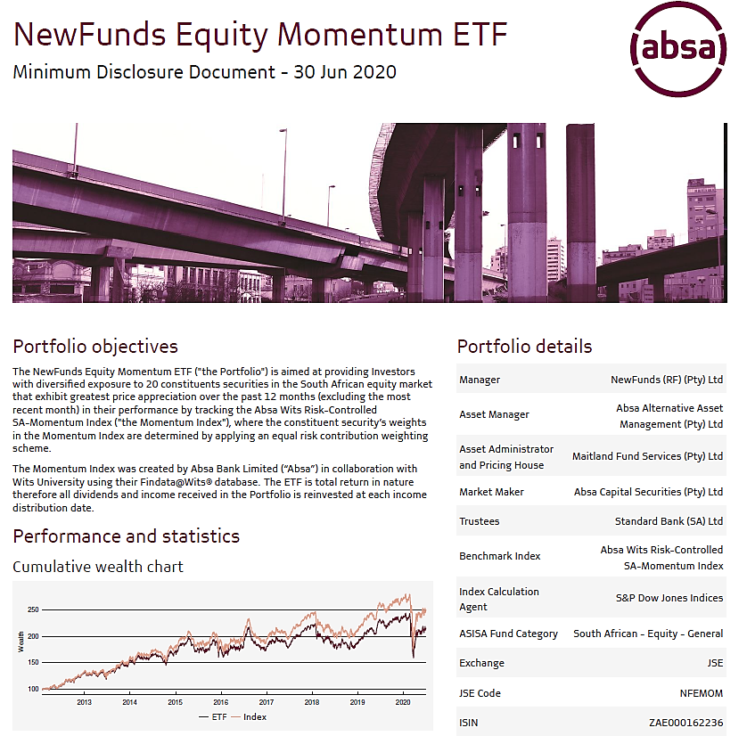
How To Read MDDs
Investment Objective
What does the ETF do/try to achieve

Slide 8

How To Read MDDs
ETF Dividends
Does the ETF distribute the dividends it receives
Look for “Distribution” not “Dividend”

Slide 9
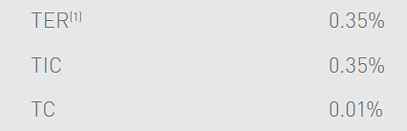
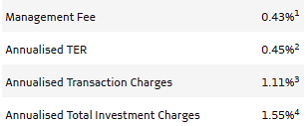
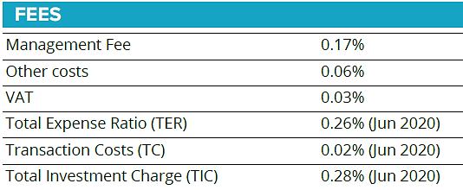

How To Read MDDs
Fees
How much does the ETF cost?
TER – Total Expense Ratio
TC – Transaction Costs
TIC – Total Investment Charge

Slide 10
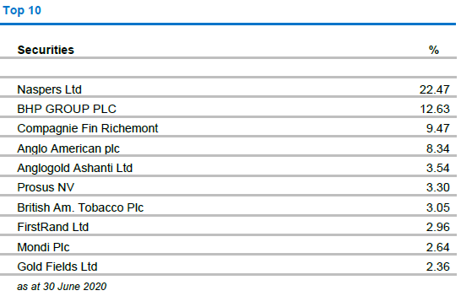
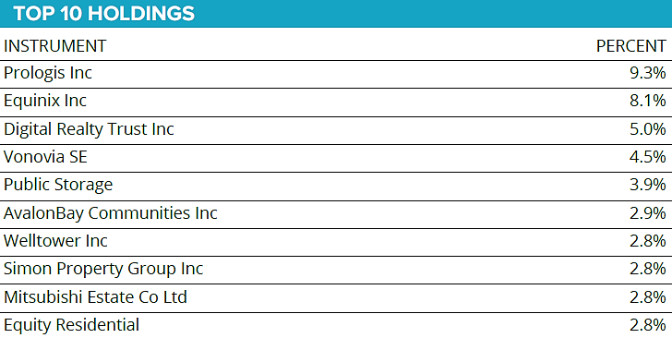
How To Read MDDs
Top 10 Holdings
What percentage of the ETF are in each of the 10 biggest holdings

Slide 11
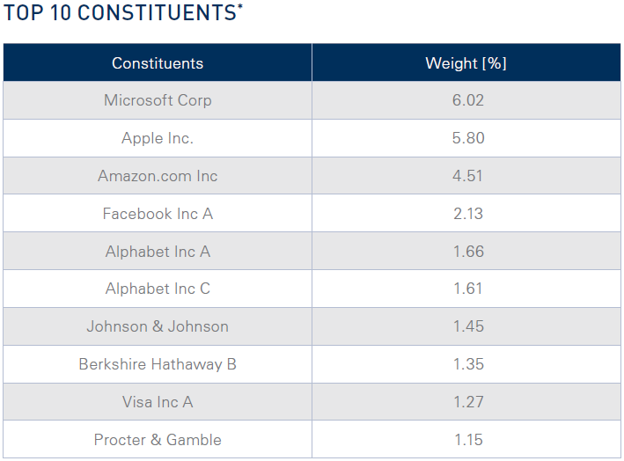
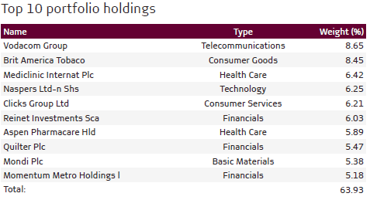
How To Read MDDs
Top 10 Holdings
What percentage of the ETF are in each of the 10 biggest holdings

Slide 12
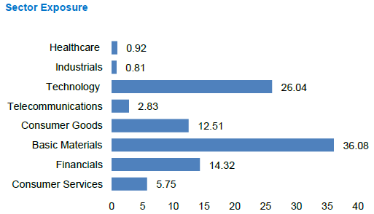
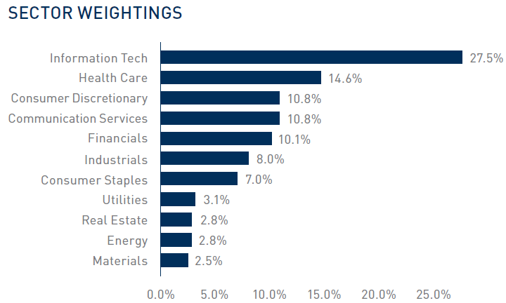
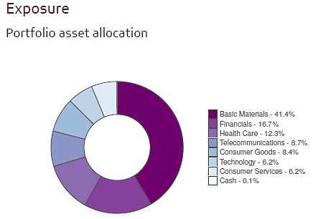
How To Read MDDs
Sector Exposure
In what industries does the ETF invest?

Slide 13
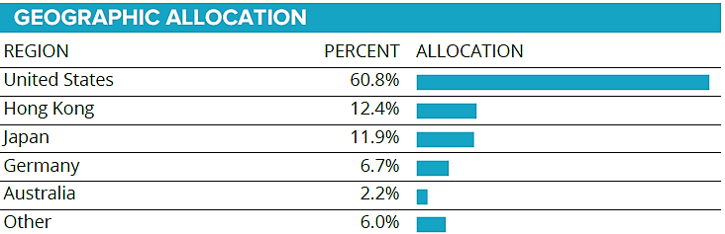


How To Read MDDs
Geographic Exposure
Where in the world does the ETF invest?

Slide 14
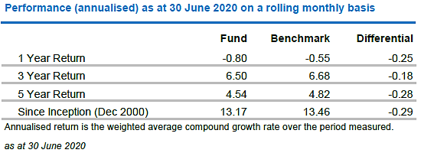
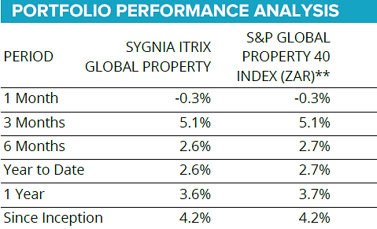
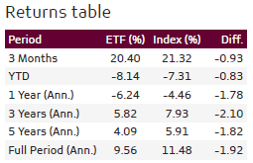
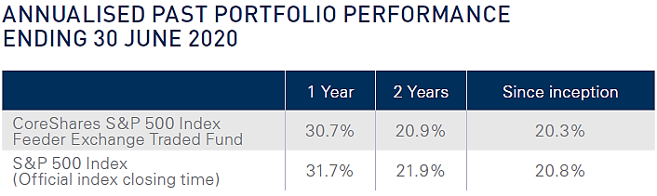
How To Read MDDs
Performance
How well has the ETF done in the past
Look for annualised – “per year”

Slide 15
Questions?

