Slide 1
Stealthy Wealth
Using ETFs To Invest For Your Child’s Education
This is not financial advice – just my approach
www.stealthywealth.co.za
@stealthy_wealth

Slide 2
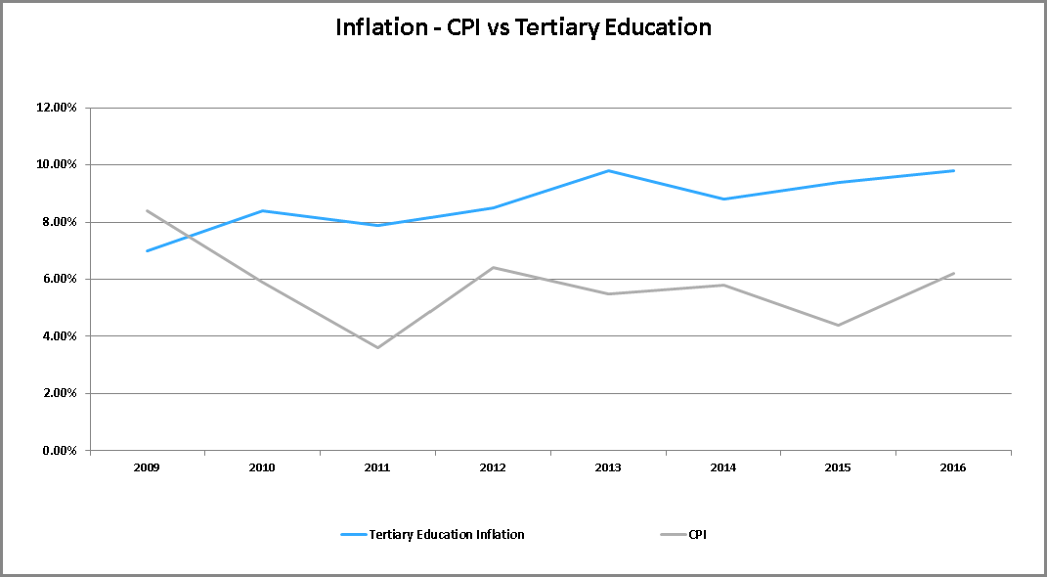
Tertiary Education Inflation
Average CPI 5.8%
Average Tertiary Education Inflation 8.7%

Slide 3
Products To Invest For Tertiary Education
FINANCIAL ADVISER
FEE
ENDOWMENT
“EDUCATION POLICY”
FEE
UNIT TRUST
FEE
SHARES

Slide 4
Products To Invest For Tertiary Education
ETF
FEE
SHARES

Slide 5

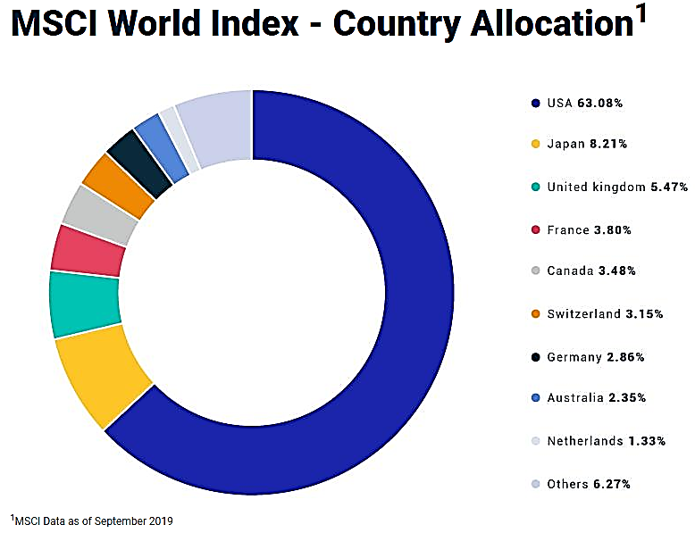
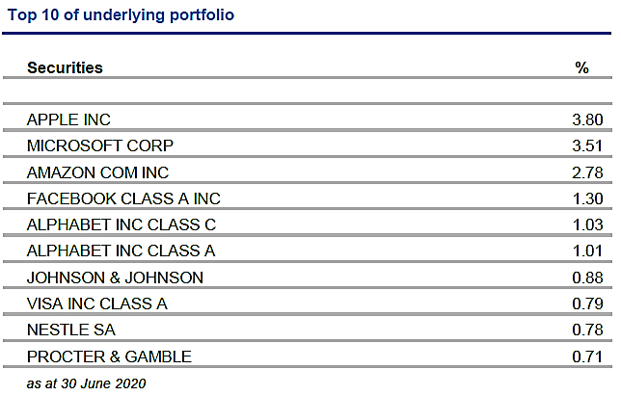
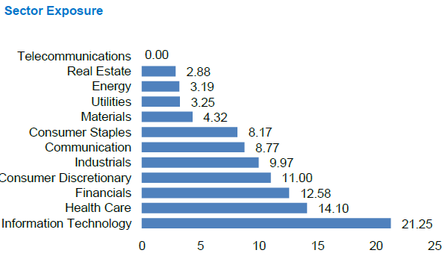
SATRIX
MSCI WORLD ETF
TER – 0.35%

Slide 6
How Much To Invest?
How much does University cost?
Which university?
Which degree?
Masters?
Local/International?
Books/Stationary/Transport?
Res?
What I did…
4 years ago – estimated tuition fees for a 4 year course ~R120k
Started putting away R500/month
Would it be enough?

Slide 7
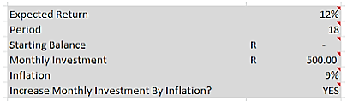
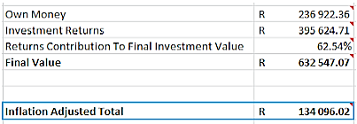
How Much To Invest?
Compound interest calculator (available at www.stealthywealth.co.za)

Slide 8
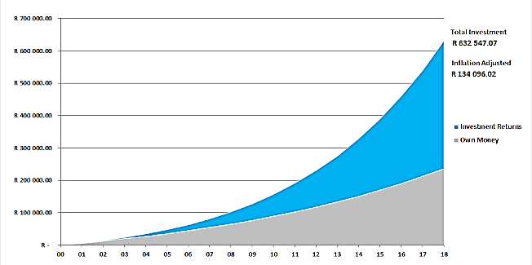
How Much To Invest?
Compound interest calculator (available at www.stealthywealth.co.za)

Slide 9
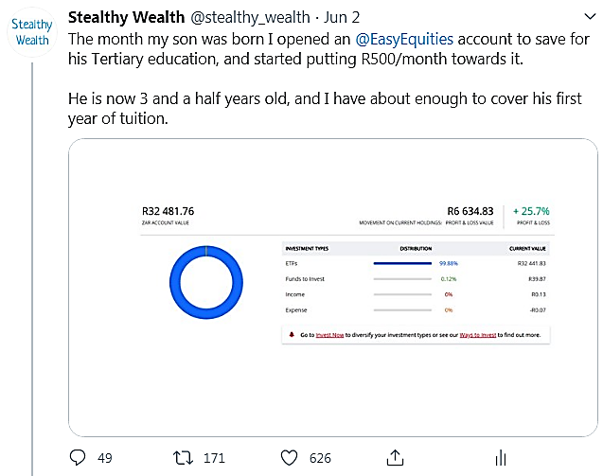
Has It Worked?
*Past performance is no guarantee of future returns, and this is not a recommendation it is just what I have decided to invest in.

Slide 10
Type Of Account?
Normal account in child’s name?
TFSA in child’s name?
Normal account in parents name?
TFSA in parent’s name?

Slide 11
Questions?

